Slide 1

Speak fluently
Intermediate

Slide 2

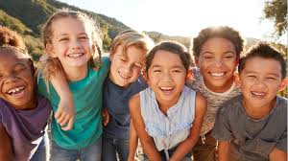
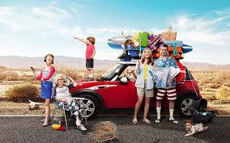
18. Vacation

Slide 3
18. Vacations
What is your happiest vacation memory?
Would you rather stay in a fancy, five-star hotel or a small, simple room?
Have your parents ever taken a vacation without you?
Would you like to go on a ski vacation?
If you were on a long vacation, would you rather stay in a hotel or a rented house or apartment?
Do students have enough vacation time?
Could you vacation in a place that had no Internet access?
What countries would you like to visit?
Are there any countries you would not like to visit?
Are vacations becoming too expensive?
11. Describe the worst vacation you’ve ever had.

Slide 4
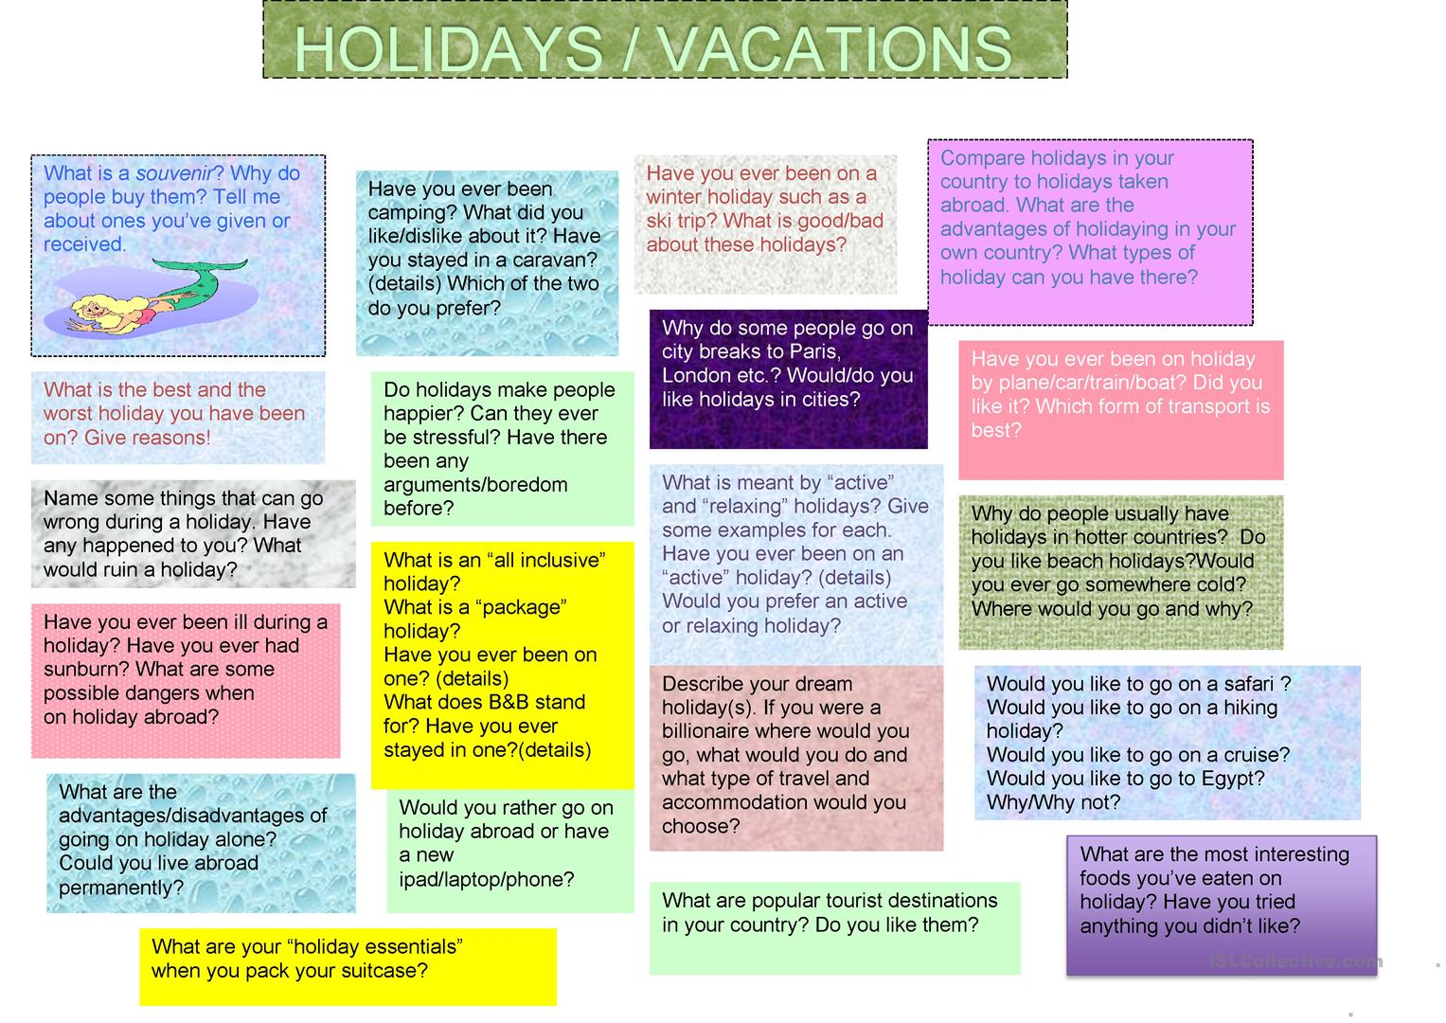
18. Vacations

Slide 5
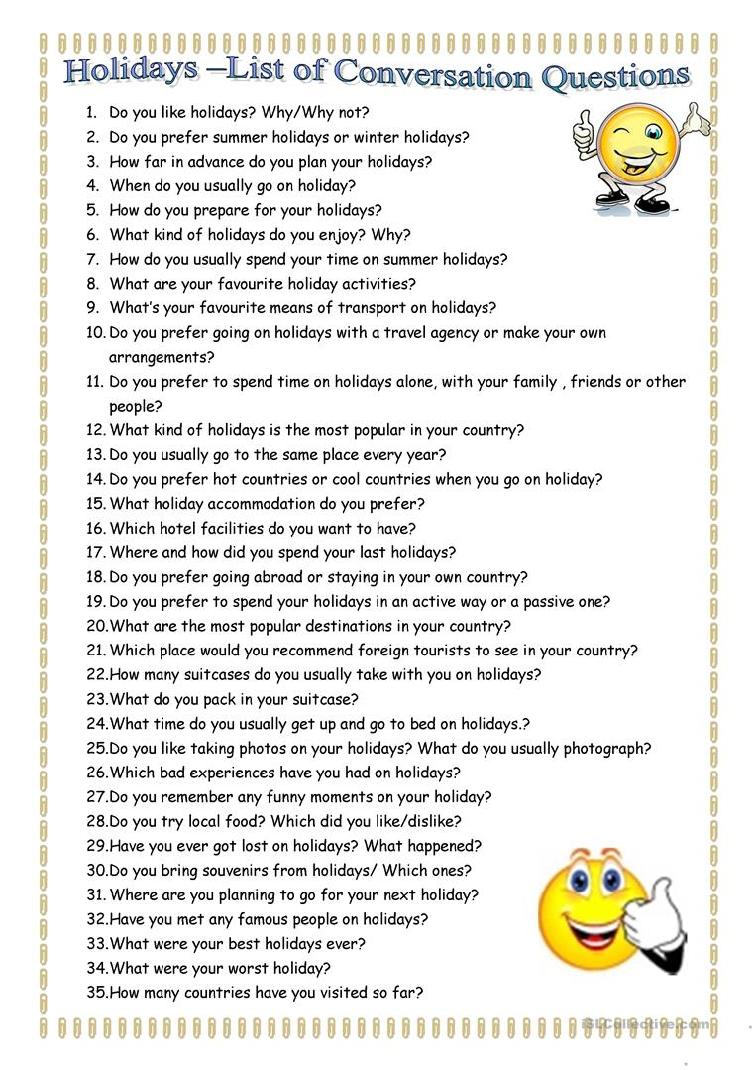
18. Vacations

Slide 6
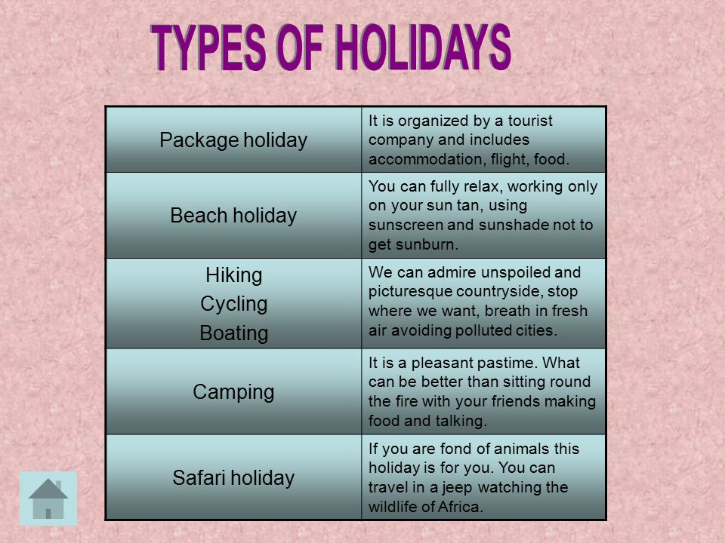
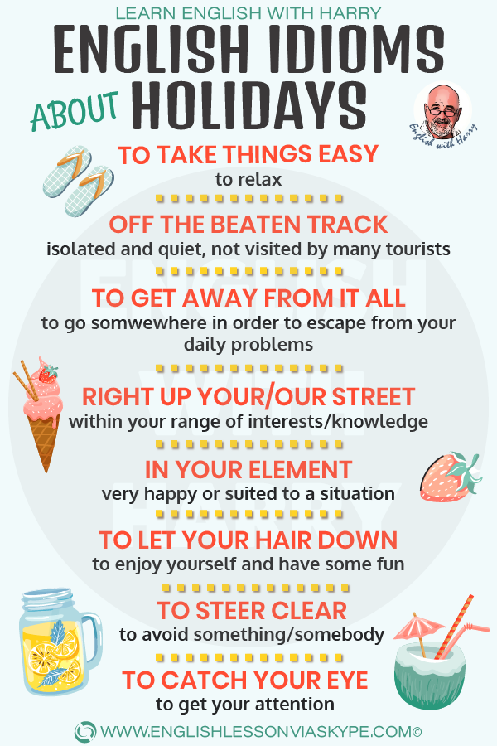
18. Vacations

Slide 7
18. Vacations
TRIP | The word trip is used to talk about a short journey somewhere for a purpose, business or pleasure. For our wedding anniversary, we went on a trip to Venice. My boss is often away on business trips. During our holiday we took a boat trip to the islands.
JOURNEY | A journey is the distance covered when travelling from one place to another. 'Journey' can refer to a long distance or a short regular one.The journey was long and tiring. It took us 5 hours to get there. Did you have a good journey? Yes, it was quite pleasant. How long is your journey to work? Just about 20 minutes.
TOUR | A tour is a journey during which several places are visited, especially on a holiday. 'Tour' can be a noun or a verb.Noun : We went on a tour of Italy. Verb : We toured the north of India.
VOYAGE | A voyage is a long journey by sea or in space.Before the 20th century, long sea voyages were common. A spacecraft will take you on a voyage through space.
• camp site – a place where you put up a tent, and park your car/caravan
• self-catering flat – a flat you rent, where you prepare your own meals
• guesthouse – accommodation a bit similar to a hotel, but with fewer services
• youth hostel – cheap accommodation, usually chosen by young people, where you share your room with others, and sleep in bunk beds
• holiday camp – accommodation in little flats or chalets with facilities such as restaurants, pubs, swimming pools, etc.

Slide 8
18. Vacations
option – choice pretty much – about charges – costs to seek compensation – to make a claim to retain – to keep out of pocket expenses – additional expenses to complete – to fill in to submit – to send
English Holiday Vocabulary - Learn Words And Phrases
according to plan – no problem last-minute hitch – a problem to travel by air – to fly lengthy – long queue (British English) = line (American English) strike – industrial action to notify in advance – to let someone know when something might happen to have a plan B – to have an alternative plan lightning strike – (British English) a situation when employees stop working without warning extended – longer than planned circumstances – situation to check out – to leave, to move out of a hotel, apartment, etc… to drag – to pull to make a contact – to call help desk – customer service desk/helpline alternative flight – another choice to turn out – to happen, to work out half of the story – not complete
• camp site – a place where you put up a tent, and park your car/caravan
• self-catering flat – a flat you rent, where you prepare your own meals
• guesthouse – accommodation a bit similar to a hotel, but with fewer services
• youth hostel – cheap accommodation, usually chosen by young people, where you share your room with others, and sleep in bunk beds
• holiday camp – accommodation in little flats or chalets with facilities such as restaurants, pubs, swimming pools, etc.

Slide 9
18. Vacations
Idioms:
1️⃣ To Take Things Easy
Meaning: to relax
Example:
After a lot of persuading he finally agreed that we both needed time to take things easy for a bit.
At this pretty traditional cottage, guests can simply sit back and take things easy.
2️⃣ Off The Beaten Track
Meaning: isolated and quiet, not visited by many tourists
Example:
My last holiday was brilliant. No internet or traffic or anything like that for a whole week. It was completely off the beaten track.
3️⃣ In Your Element
Meaning: very happy/suited to a situation
Example:
I was in my element. A bit of walking or fishing with no one telling you what to do.
4️⃣ Run-Of-The-Mill
Meaning: ordinary and unexciting place
Example:
I’m really tired of the same run-of-the-mill holiday places. This summer I want to go somewhere new.
5️⃣ As Brown As A Berry
Meaning: very suntanned
Example:
When I arrived home after my holidays I was as brown as a berry and felt great.

Slide 10
18. Vacations
Idioms:
6️⃣ Round The Clock
Meaning: all day and all night
Example:
This holiday destination has it all. White sandy beaches and round-the-clock bars and discos where you can dance all night.
7️⃣ To Get Into The Swing Of Something
Meaning: to become accustomed to something and start enjoying it
Example:
Going on holidays on your own can be nerve-racking, but once you get into the swing of it, you’ll really enjoy it.
8️⃣ To Steer Clear Of
Meaning: to avoid something/somebody
Example:
If you are not a fan of the hot weather, steer clear of this area in the summer months.
Since curry upsets my stomach, I steer clear of it.
9️⃣ To Let Your Hair Down
Meaning: to enjoy yourself and have some fun
Example:
On the first day of my summer holiday in Italy, I was in the mood for letting my hair down.

Slide 11
18. Vacations
Idioms:
1️⃣0️⃣ A New Lease Of Life
Meaning: a burst of new energy and enthusiasm
Example:
I returned home with a glow and looked healthy again. I had energy. It was a new lease of life.
1️⃣1️⃣ To Get Away From It All
Meaning: to escape from your daily problems
Example:
We decided to go to a desert island so that we could get away from it all.
1️⃣2️⃣ To Catch Your Eye
Meaning: to get your attention
Example:
The beautiful dress in the shop window caught my eye, so I went in and bought it.
Cheap flights seat sales caught my eye last week and I decided to book flights to Majorca.
1️⃣3️⃣ Right Up Your Street
Meaning: within your range of interests/knowledge
Example:
This place sounds right up my street, I’m going to book it for next summer.

Slide 12
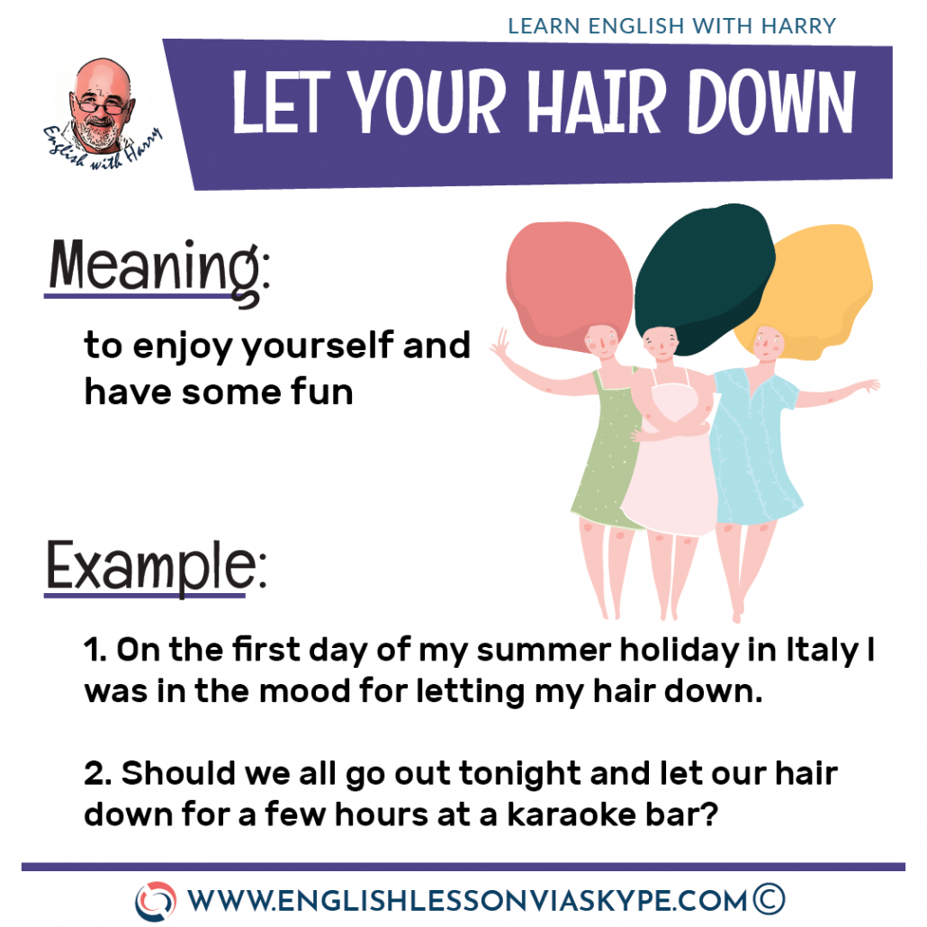
18. Vacations

